Slide 1


AI Saturdays Kickoff
AI6 Week 0
Oxygen AI
Optimize Your Outcomes

Slide 2
Agenda
Description of the program
Curriculum
Format of the Sessions
Timeline
Needs
Recommended time per week
Typical tasks/assignments
Fast AI Detailed Overview
CS224n Detailed Overview
Week 1 Content
Fast AI
CS224n

Slide 3
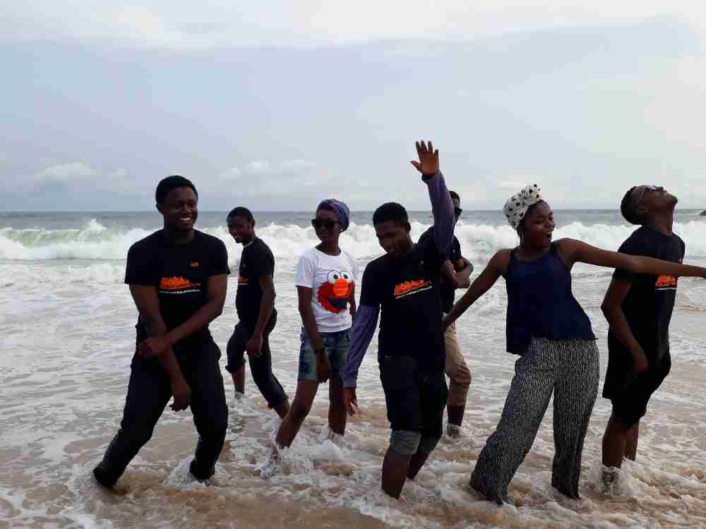
AI Saturdays (AI6) Overview
Free Structured Group Study for Learning Practical Deep Learning
50+ Cities; 5000+ Participants
Outputs Include Unique Project and Papers
Registration: Link in Notes
AI6 Media
Facebook: “AI Saturdays” & @ai6.north.cali
Twitter: @AISaturdays & @SaturdaysAi
Medium
https://medium.com/ai-saturdays
Forums
https://ai6forums.nurture.ai/
Slack: aisaturdays.slack.com
Notes:
AI6 Registration Form: https://docs.google.com/forms/d/e/1FAIpQLSd0wx35dx1NJI2C_ciyzoplneu1igltvEACI5KLN6FPWrhO8w/viewform

Slide 4
Curriculum
Fast.ai - Practical Deep Learning For Coders - Part 1
Stanford CS224n: NLP with Deep Learning

Slide 5
Session Format
Session Content
Discussions: Summary of Week’s Content with discussions and Q&A.
Paper Discussion: Led discussion and presentation of Journal Article and implementation
Coding Period: Group Coding Session or Relevant Projects
Typical Saturday Schedule
845AM – Sign-in
9AM - Fast AI Discussion
10AM - Break
1030AM - CS224n Discussion
1130 - Break
12PM - Paper Discussion or Project Coding
1PM - Close

Slide 6
2018 Schedule

Slide 7
Current Needs
Volunteers
Facilitate Paper Discussions and Weekly Course Content
Venue
Permanent Venue Needed to Host Group
Snacks
Feel Free to Bring and Share Snacks/Pizza!

Slide 8
Weekly Required Pre-Work
Task | Time
Watch Video | 1.5 – 2 Hours
Read Articles and Papers | 2 Hours
Coding Practice | 5 – 6 Hours
Total | 9 -10 Hrs/Week
Assumptions
Only one track is taken
Work done daily in small increments vs. huge cramming on Friday
Coding time may include project work
Bare Minimum – Watch Video & Minimum Code Practice (3 hours/wk)

Slide 9
Infrastructure Needed
Python & Notebooks: Recommend Anaconda
Text Editor: Recommend Atom or Visual Studio
GPU – Enabled Machine: Several Sources:
(https://github.com/reshamas/fastai_deeplearn_part1/blob/master/README.md#platforms-for-using-fastai-gpu-required)
Paperspace
AWS
Google Cloud
Crestle
Etc…..
Git & Github:
AI6 Code shared on Github;
Fast.ai code and platform on Github

Slide 10
Fast AI Detailed Overview
“Learn how to build state of the art models without needing graduate-level math—but also without dumbing anything down.”
Weekly Course Content
Recognizing Cats and Dogs
Improving Your Image Classifier
Understanding Convolutions
Structured, Time Series & Language Models
Collaborative Filtering. Inside the Training Loop
Interpreting Embeddings. RNN from Scratch
Resnets from Scratch

Slide 11
CS224n Detailed Overview
Weekly Course Content
Intro to NLP & Deep Learning
Word Vectors 1
Word Vectors 2
Neural Networks
Back Propagation
Intro to TensorFlow
Dependency Parsing
RNN and Language Models
Vanishing Gradients, Fancy RNNs
Machine Translation, Seq2Seq and Attention
Advanced Attention
Transformer Networks and CNNs
Co-reference Resolution
Tree RNNs and Constituency Parsing
Advanced Architectures and Memory Networks
Reinforcement Learning for NLP
Semi-Supervised Learning for NLP
Future of NLP Models, Multi-task Learning and QA Systems
“Students will learn to implement, train, debug, visualize and invent their own neural network models.”
Notes:
Syllabus: http://web.stanford.edu/class/cs224n/syllabus.html

Slide 12
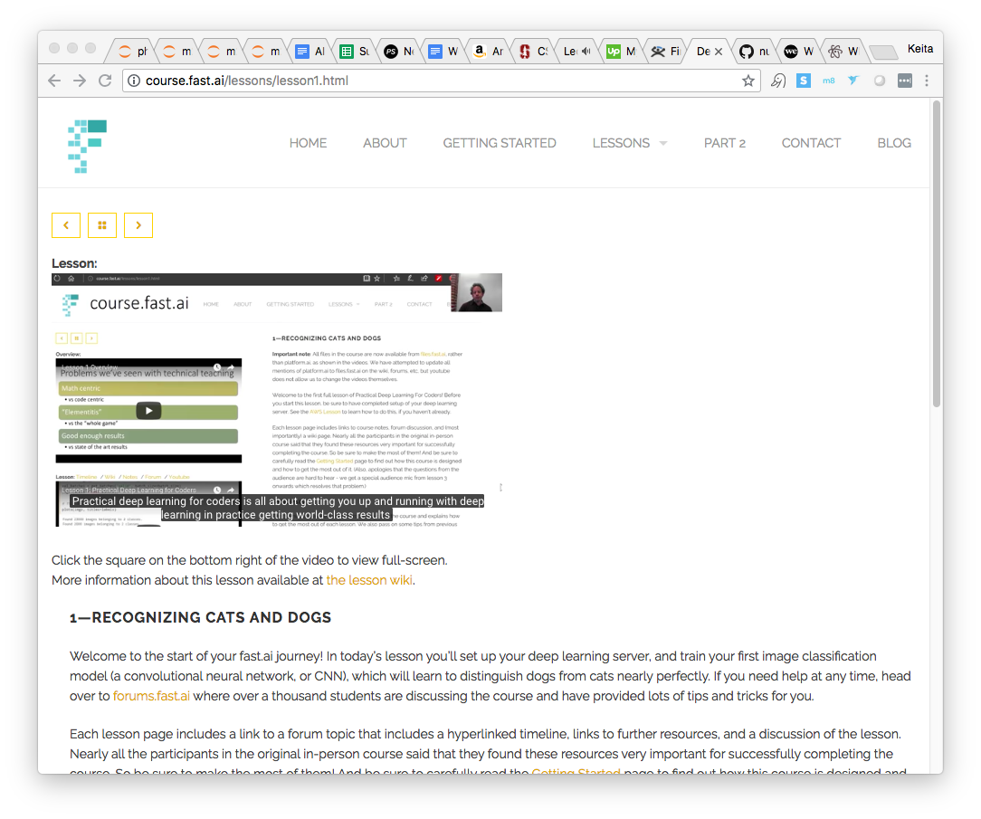
Fast AI – Week 1
Pre-Work
Video: http://course.fast.ai/lessons/lesson1.html
Lesson Wiki: http://forums.fast.ai/t/wiki-lesson-1/9398
Reading: Found in Lesson Wiki
Coding Goals:
Minimum: run through the Notebook and understand it
Ideal: Recreate the code from scratch without aid

Slide 13
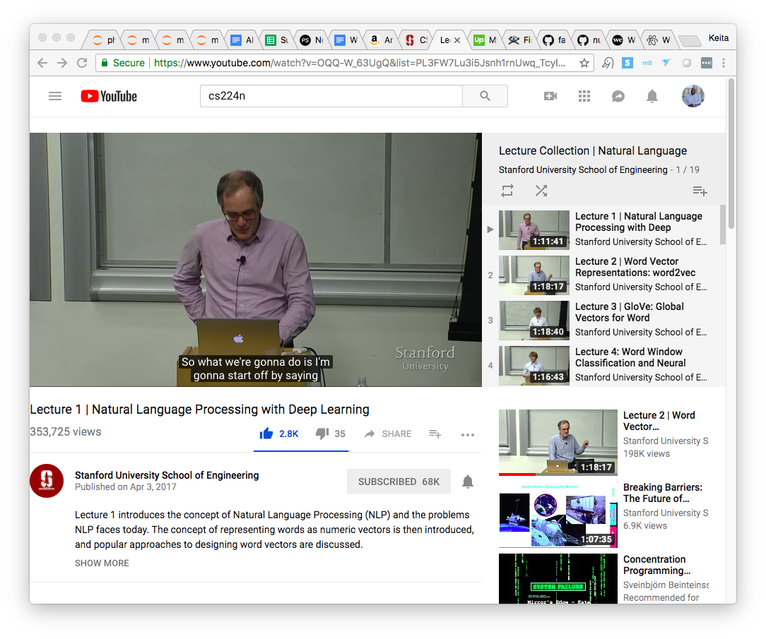
CS224n – Week 1
Pre-Work
Video:
https://www.youtube.com/watch?v=OQQ-W_63UgQ&list=PL3FW7Lu3i5Jsnh1rnUwq_TcylNr7EkRe6
Slides: http://web.stanford.edu/class/cs224n/lectures/lecture1.pdf
Reading:
[Linear Algebra Review]
[Probability Review]
[Convex Optimization Review]
[More Optimization (SGD) Review]

